Slide 1


Redefining
Mobile Advertising
Sponsor - Cheetah Mobile Point of contact - Arthur Wu, Leslie Liang, Tyler Hayes Faculty Advisor - Patrick Tague Team - Akshay, Vinay, Xi, Kailiang
Fall 2015
INI Project Practicum

Slide 2
Agenda
Introduction
Motivation
Related work
System Design & Implementation
Demo
Experiments & Analysis
Conclusion & Future Work

Slide 3

Introduction

Slide 4
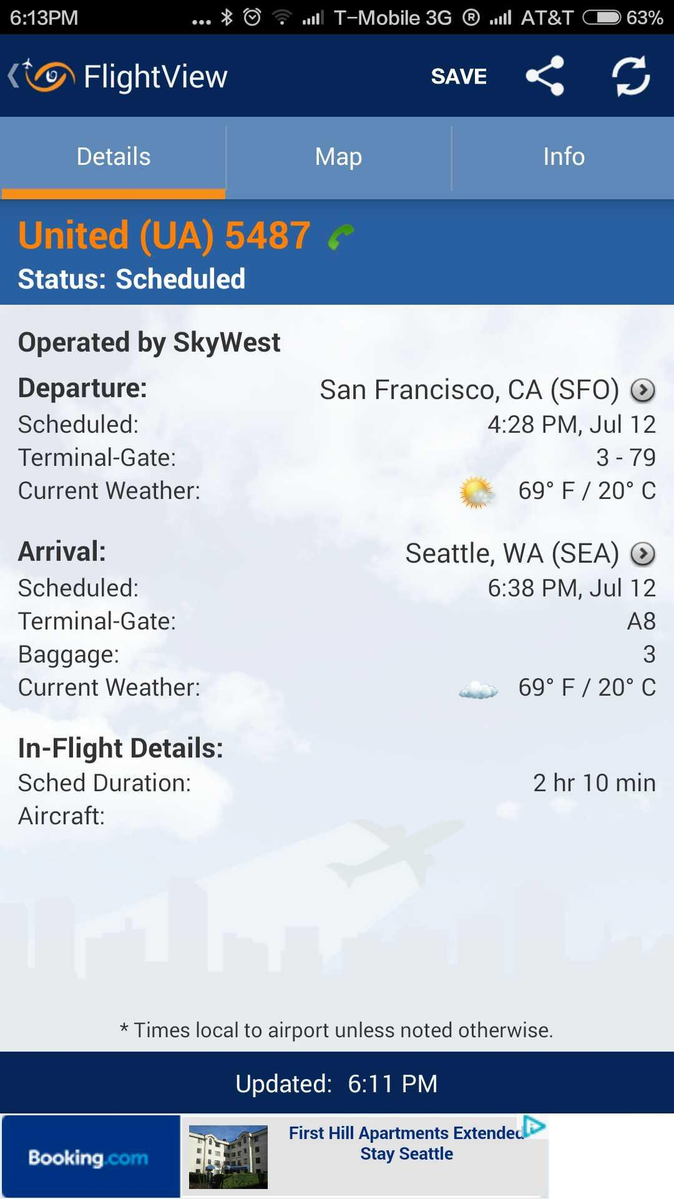
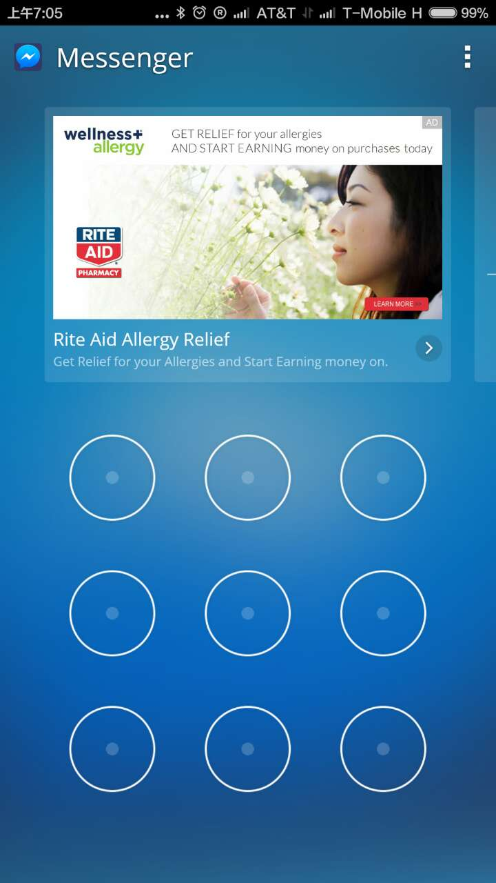
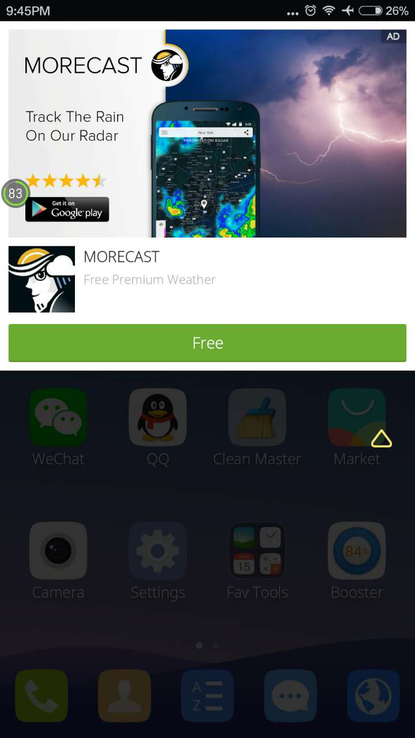
Mobile Advertising
Form of advertising via mobile phones or other devices, promoting products or services to real mobile users.

Slide 5
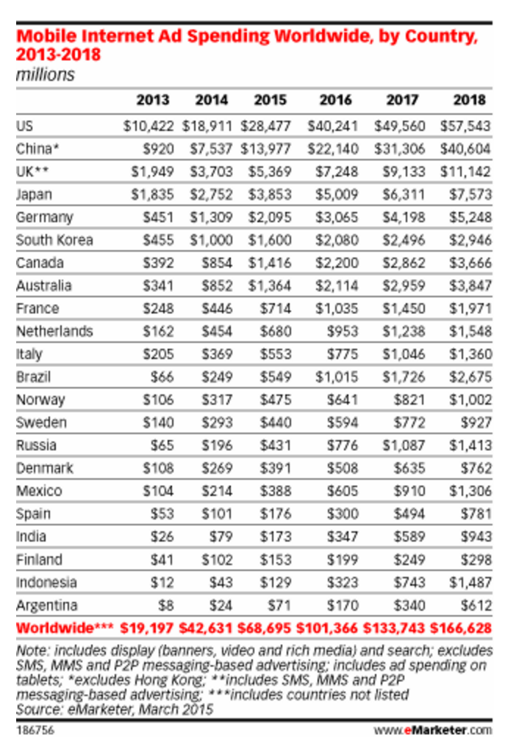
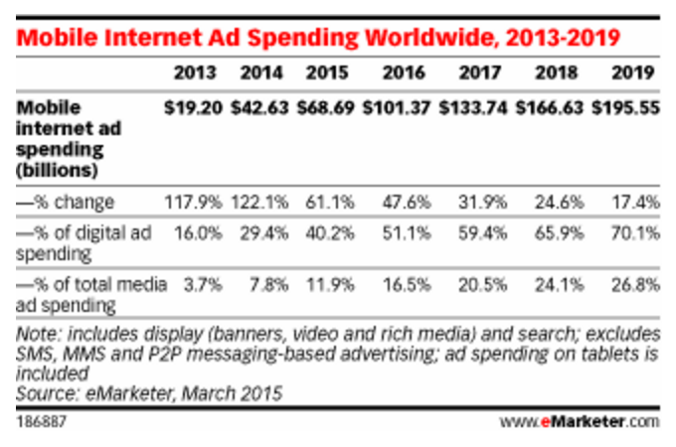
Mobile Ads Market
Mobile Ads market is a huge(billion level) business, and still fast growing. [1]

Slide 6
Motivation

Slide 7

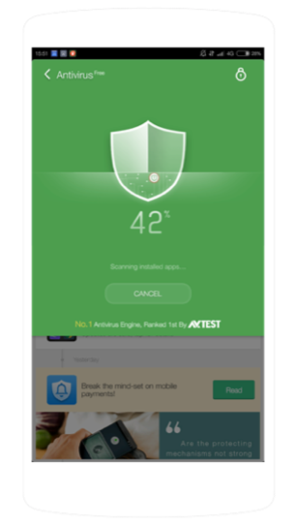




Exploring Mobile Advertising
Banner
Interstitial
Video
Native

Slide 8
Explore Advertising Formats
Banner
Trend
First generation ad unit
More popular in developing countries
Pros
Cons
Industry standard
Lower click rate
On-Screen button/header

Slide 9
Different Mobile Advertising Formats
Interstitial
Highlight
App feature related
Full-screen
Pros
Cons
High performance
More Impressions
More intrusive
Worse UX
In the middle of behavior flow

Slide 10
Different Mobile Advertising Formats
Video
Trend
Demand is growing
Highlight
Expresses more information about app/product
Pros
High engagement
Interactivity of mobile touchscreens
Immersive full-screen experience
Almost everywhere
Game (incentivized)

Slide 11

Exploring Potential of Native Advertising
Banner
Interstitial
Video
Native

Slide 12

Native Ads
Trend
New trend. Facebook is the leader of native.
Highlight
Must-have elements – title, description, big picture, small icon, button.
Better performance.
Seamlessly embedded
in diverse app scenarios

Slide 13
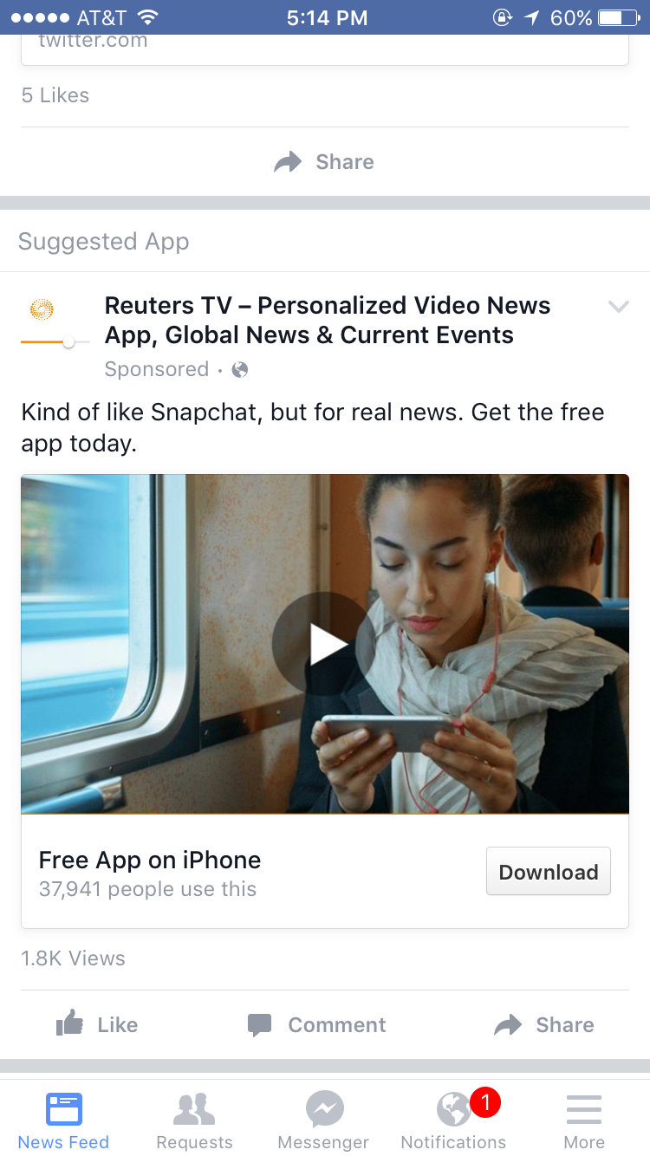
Anatomy of Native Ads
Small Icon
Title
Description
Big Picture or video
Call to action

Slide 14
Related Work

Slide 15
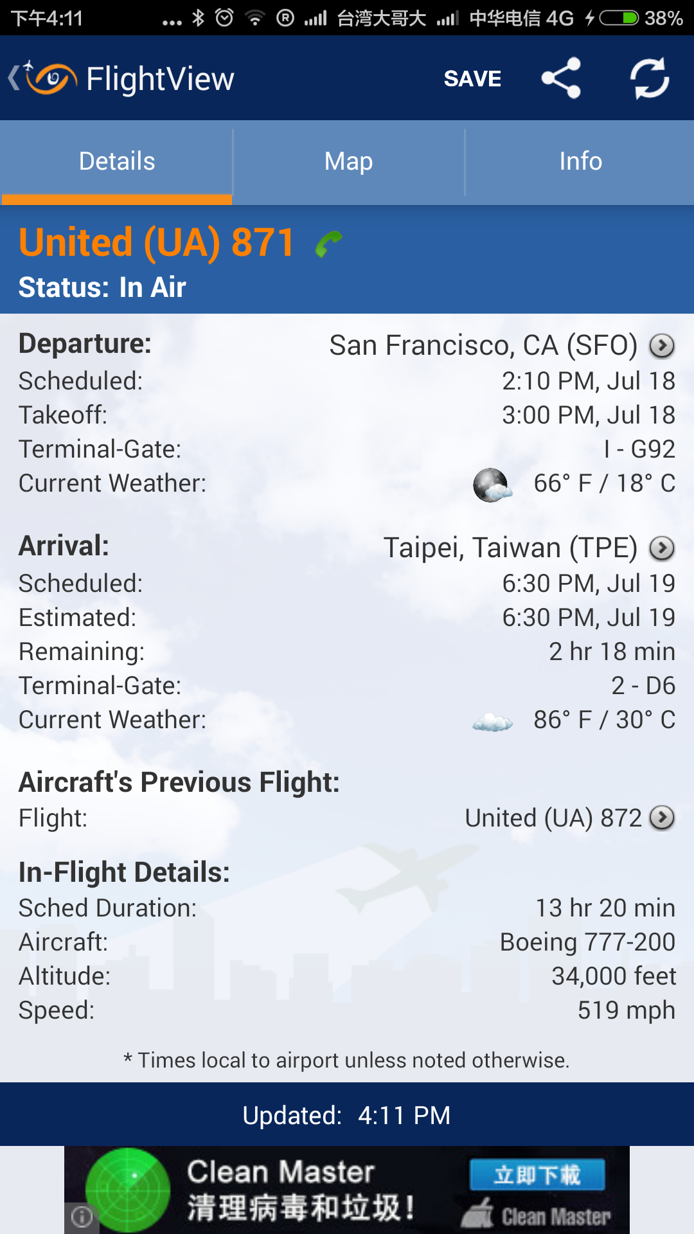
Bottom Banner Ads Usage

Slide 16
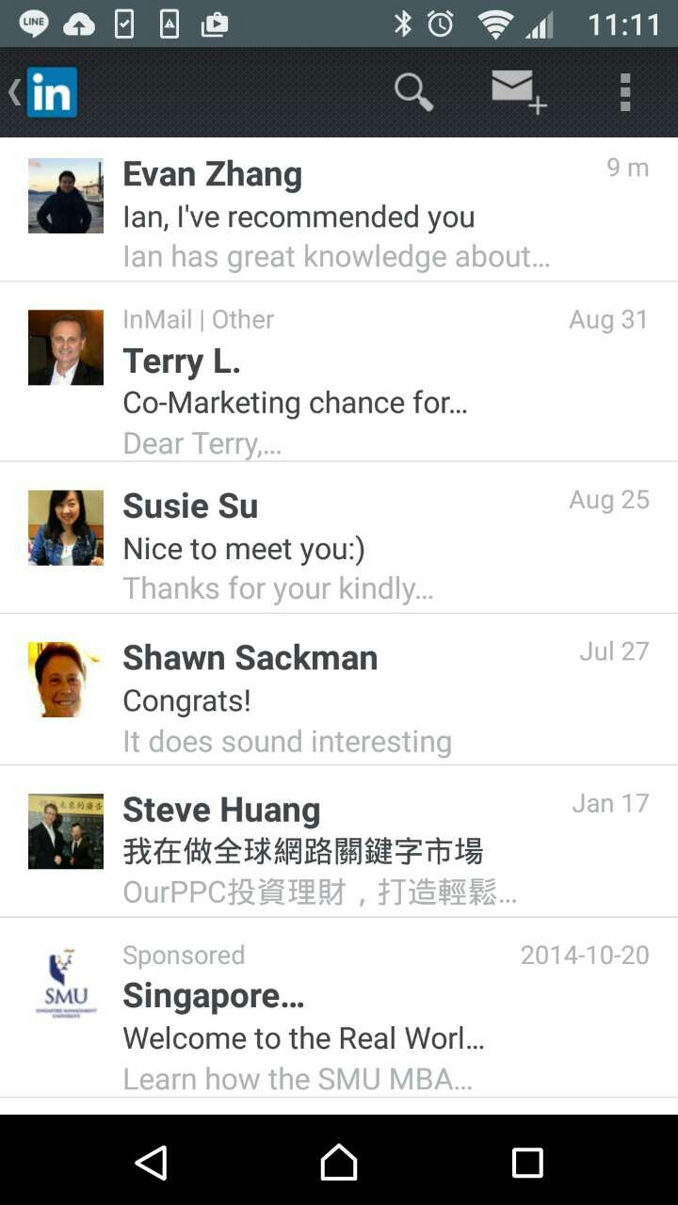
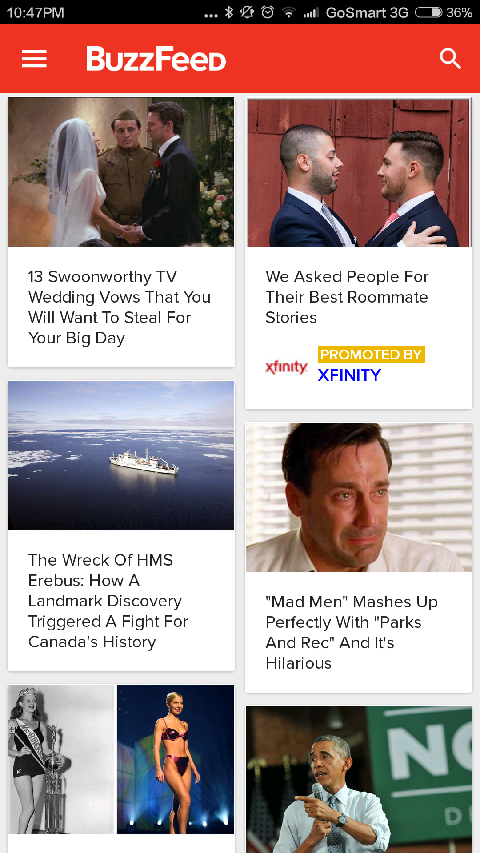
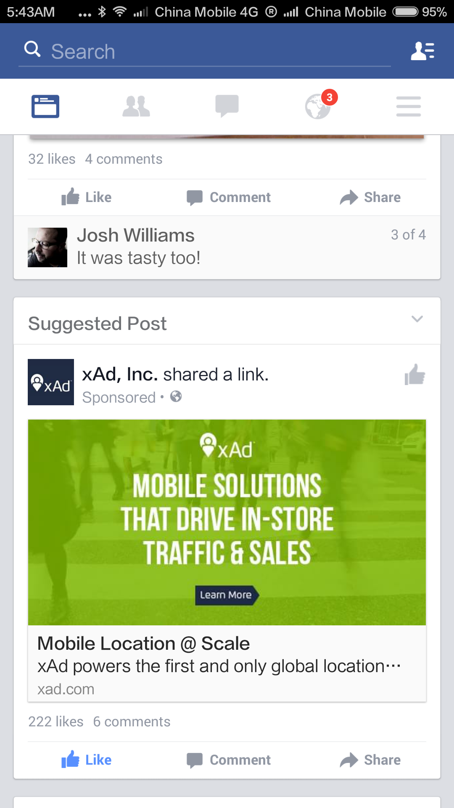
Native Ads Usage

Slide 17
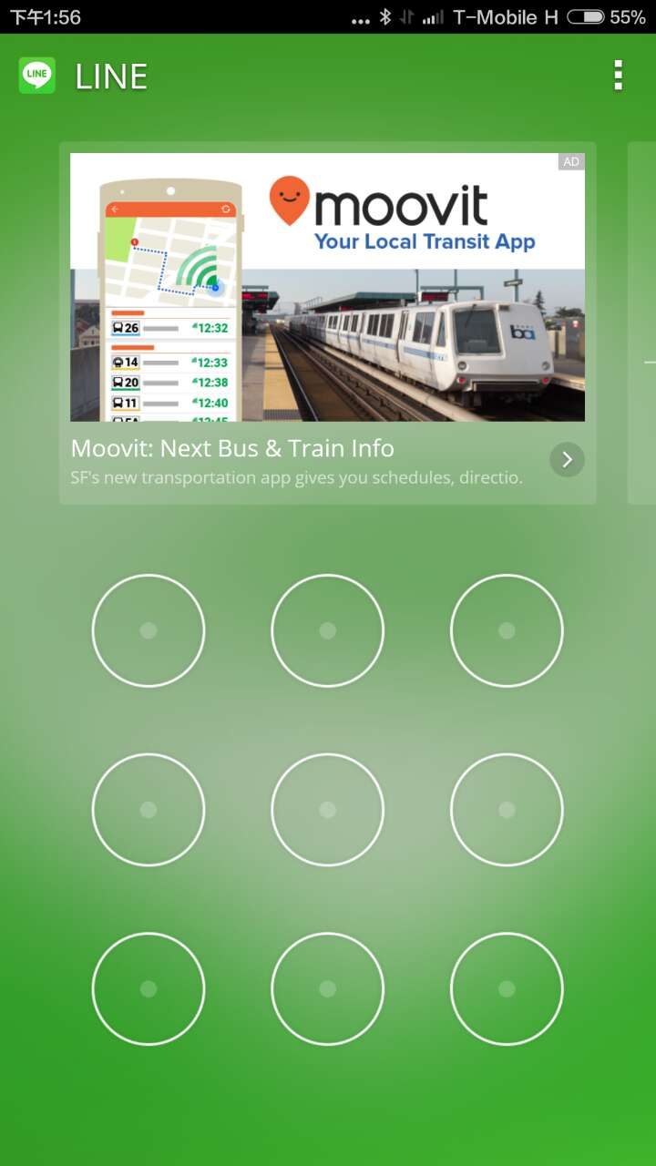
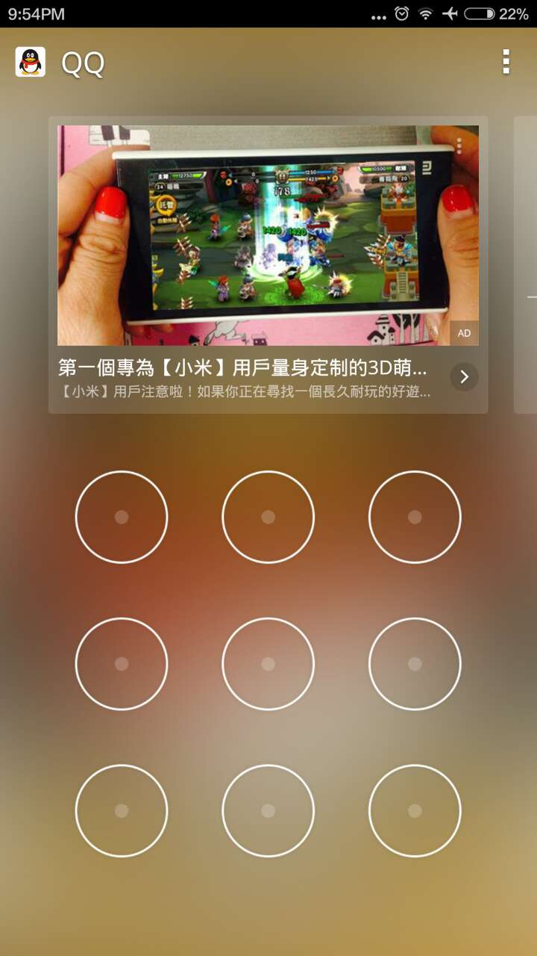
Cheetah Mobile (Clean Master / CM Security / Battery Doctor)

Slide 18
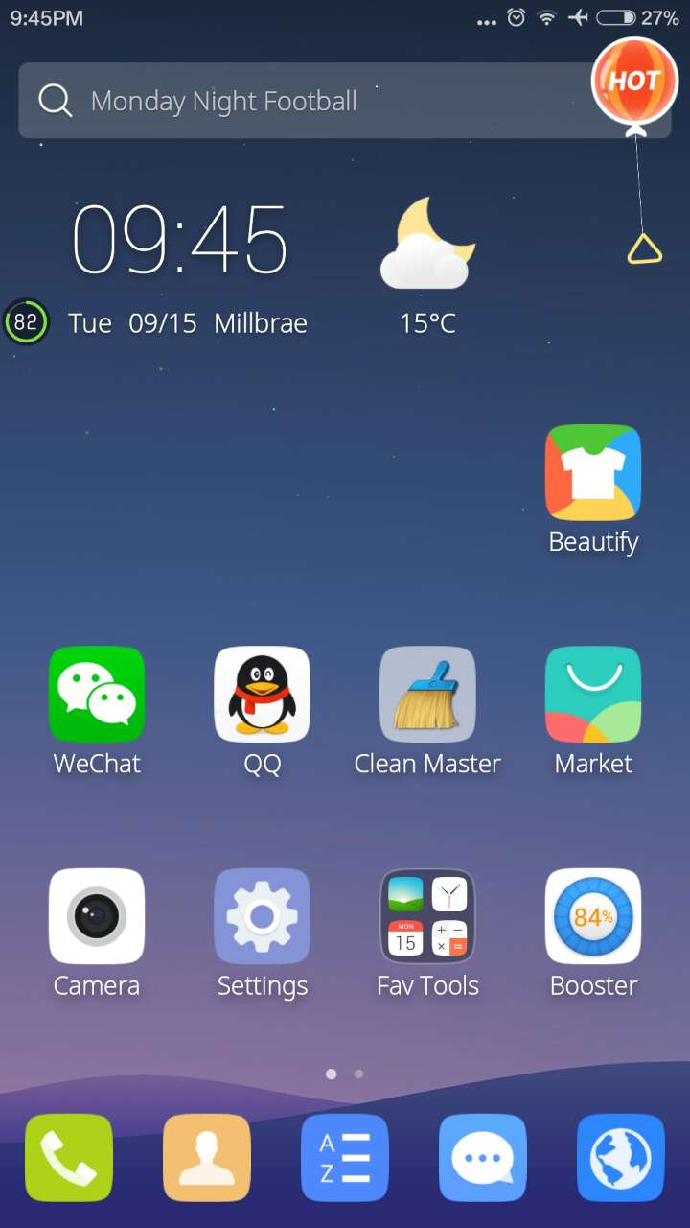

Slide 19
Proposed Method -1
What the GIF

Slide 20
System Design
Advertising Ecosystem
Yahoo Flurry Network
Facebook Audience Network
5
4
Feed
Create Story
9
View Story
1
What the GIF
8
2
7
6
3
GifFeed Server
Parse
Giphy API
Acquired by Facebook

Slide 21
Development Process
2 week sprints
Continuous software development process[2]
Growing user subset with each build
Build
5 build released.
Release
Deploy
Last build deployed 4 days back.
Test
2 rounds of Live Play Testing

Slide 22
Demo!
What the GIF
https://www.dropbox.com/s/ihml84ogfe7lfs4/device-2015-12-08-132955.mp4?dl=0

Slide 23
Experiment & Analysis
What the GIF

Slide 24
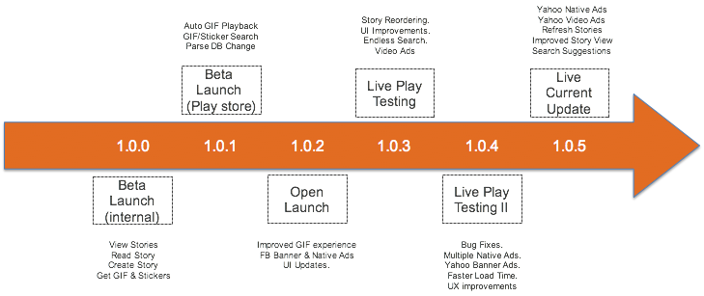
Experiment Timeline

Slide 25
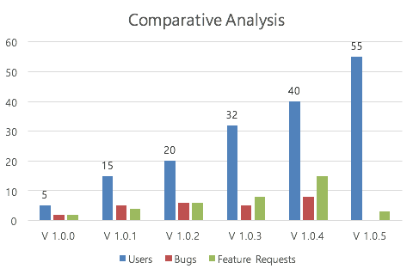
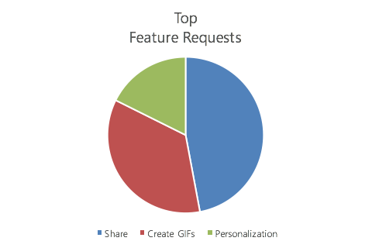
Analysis & Results
Live Play Testing Feedback
10%
60%
30%

Slide 26
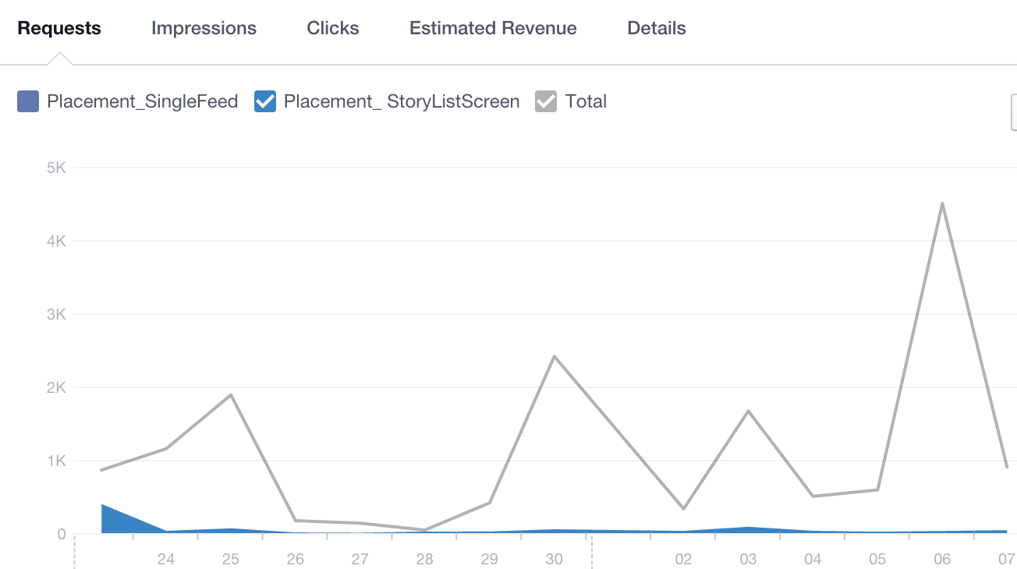
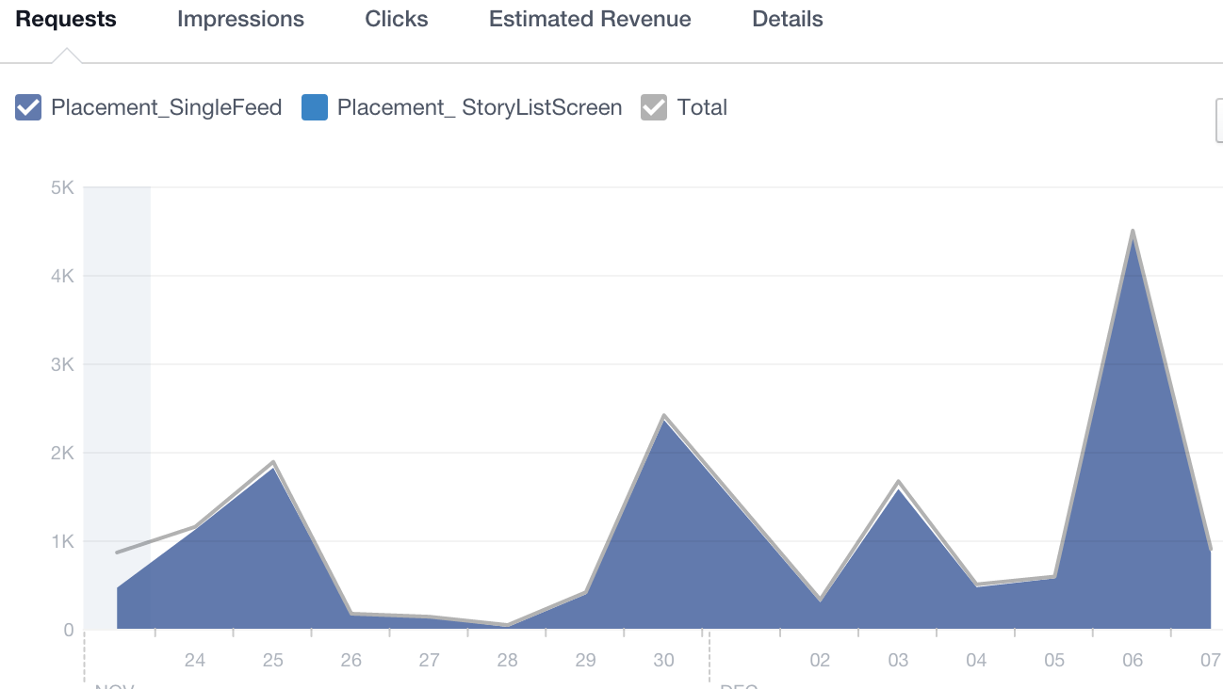
Analysis & Results
Facebook Ads Performance Analysis
Banner Requests
Native Requests

Slide 27
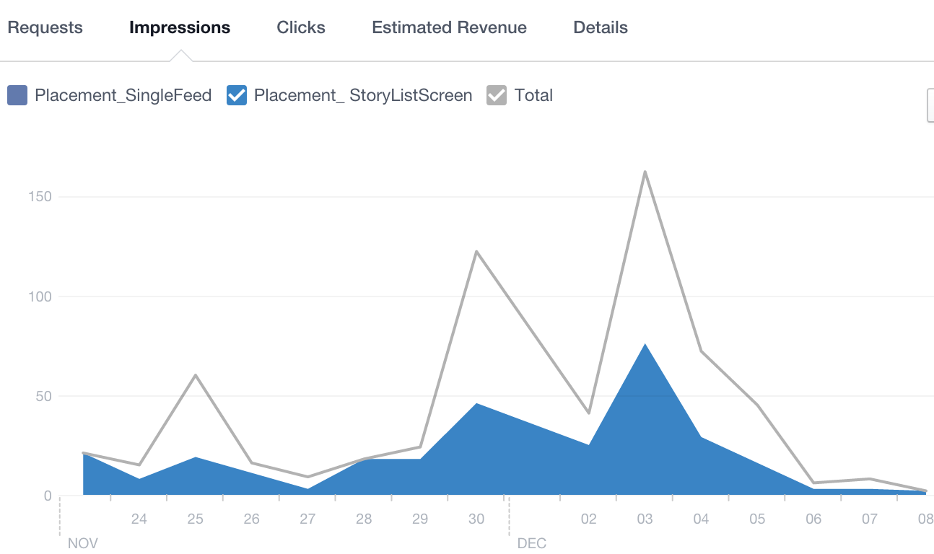
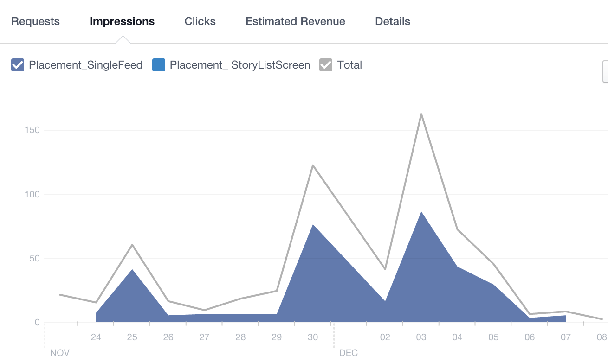
Analysis & Results
Facebook Ads Performance Analysis
Banner Impressions
Native Impressions

Slide 28
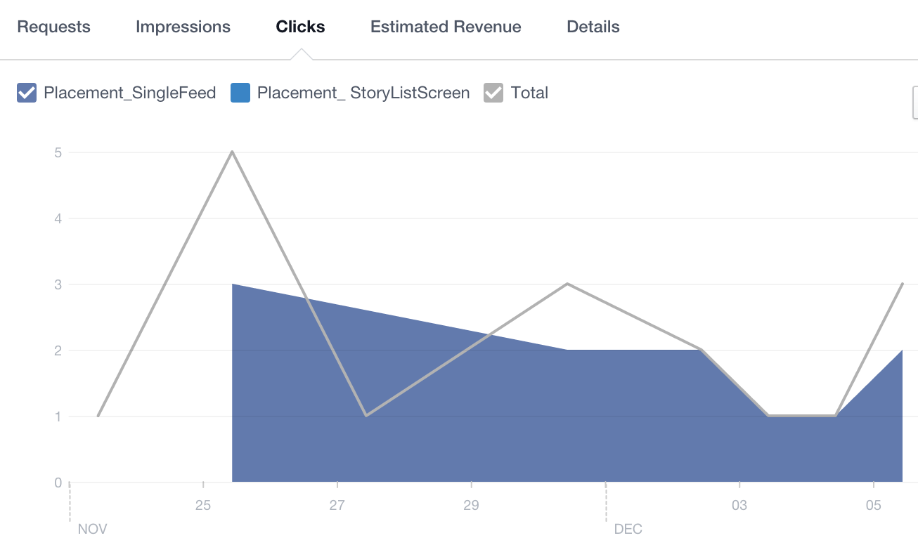
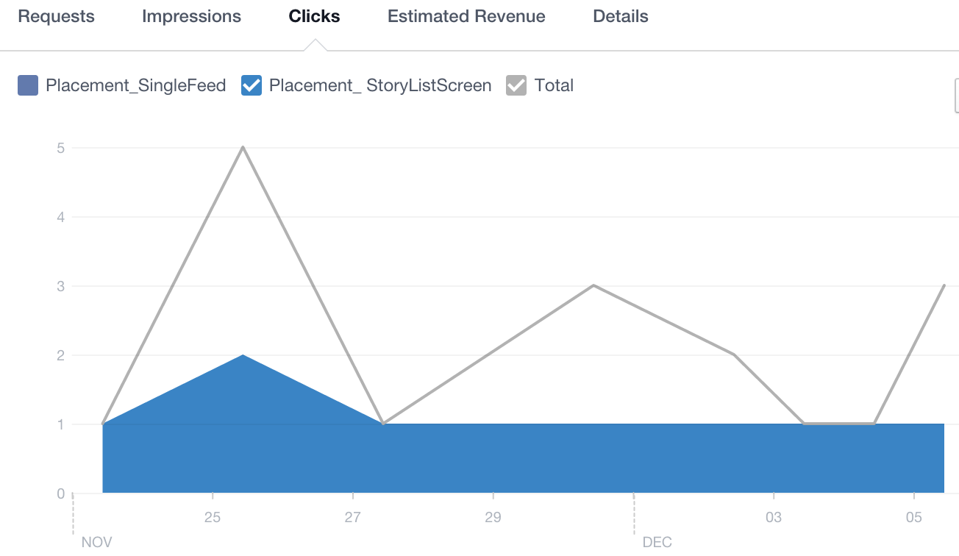
Analysis & Results
Facebook Ads Performance Analysis
Banner Clicks
Native Clicks

Slide 29
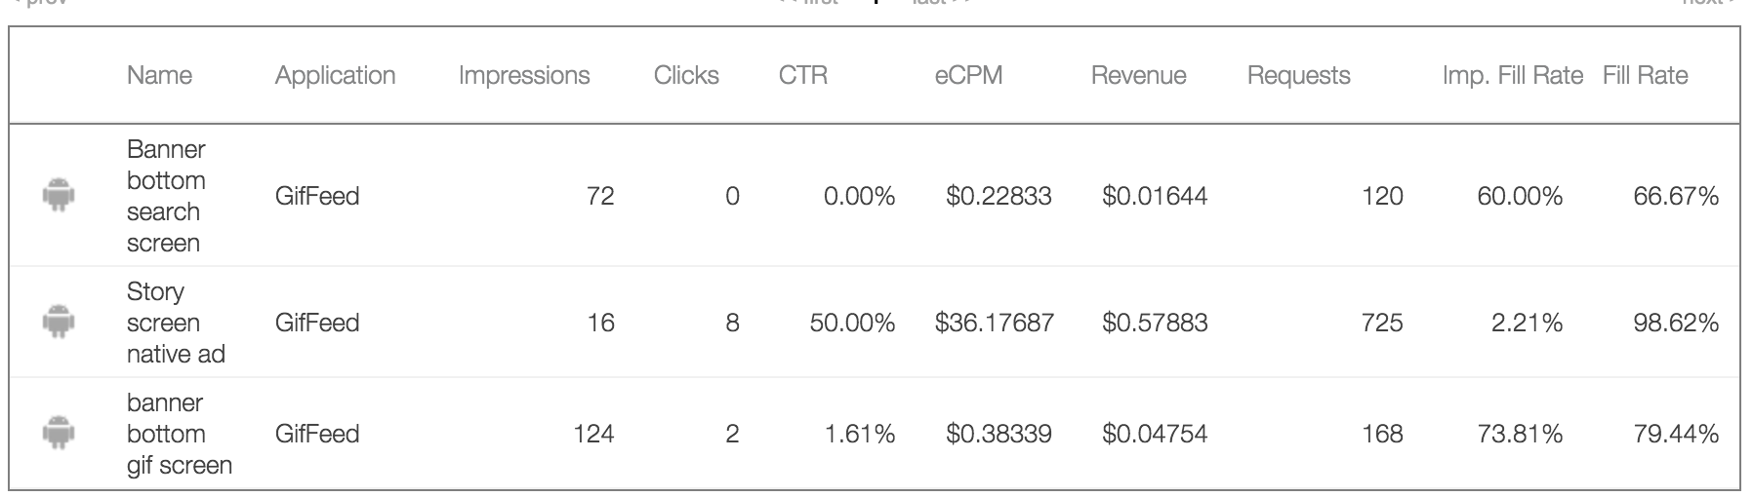
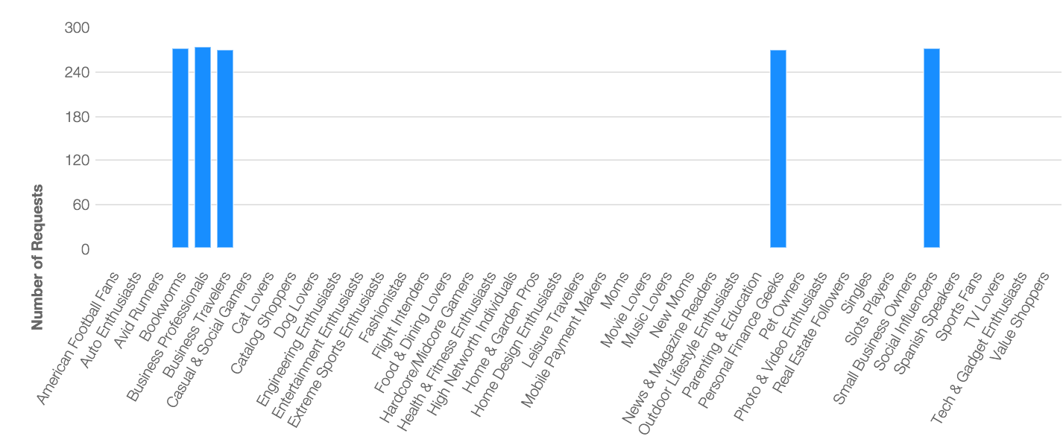
Analysis & Results
Yahoo Ads Performance Analysis
Snapshot of performance
Top Personas
Top Personas: Social Influencers, Geeks, Bookworms

Slide 30
Analysis & Results
Advertising formats feedback
Ad Placements & Formats | Expected Outcome | Actual Outcome
Banner ad on top of the home screen | Intrusive experience | Intrusive experience
Bottom banner ads on the GIF screen | Neglected | Actually viewed by users
Native ad as part of each story | Great in-stream experience. | Users get fooled by the blended experience.
Native & video ads as part of the stories | seamlessness & continuity | As expected.

Slide 31
Analysis & Results
Feedback based improvements
Clear Identification of sponsored native content in-stream.
Relevancy of Native ads.
Optimize quantity & position of ads in-stream.
Seamless prefetching of advertising content.
Keeping the creation process Ad-free.

Slide 32
Proposed Method -2
PicKick

Slide 33
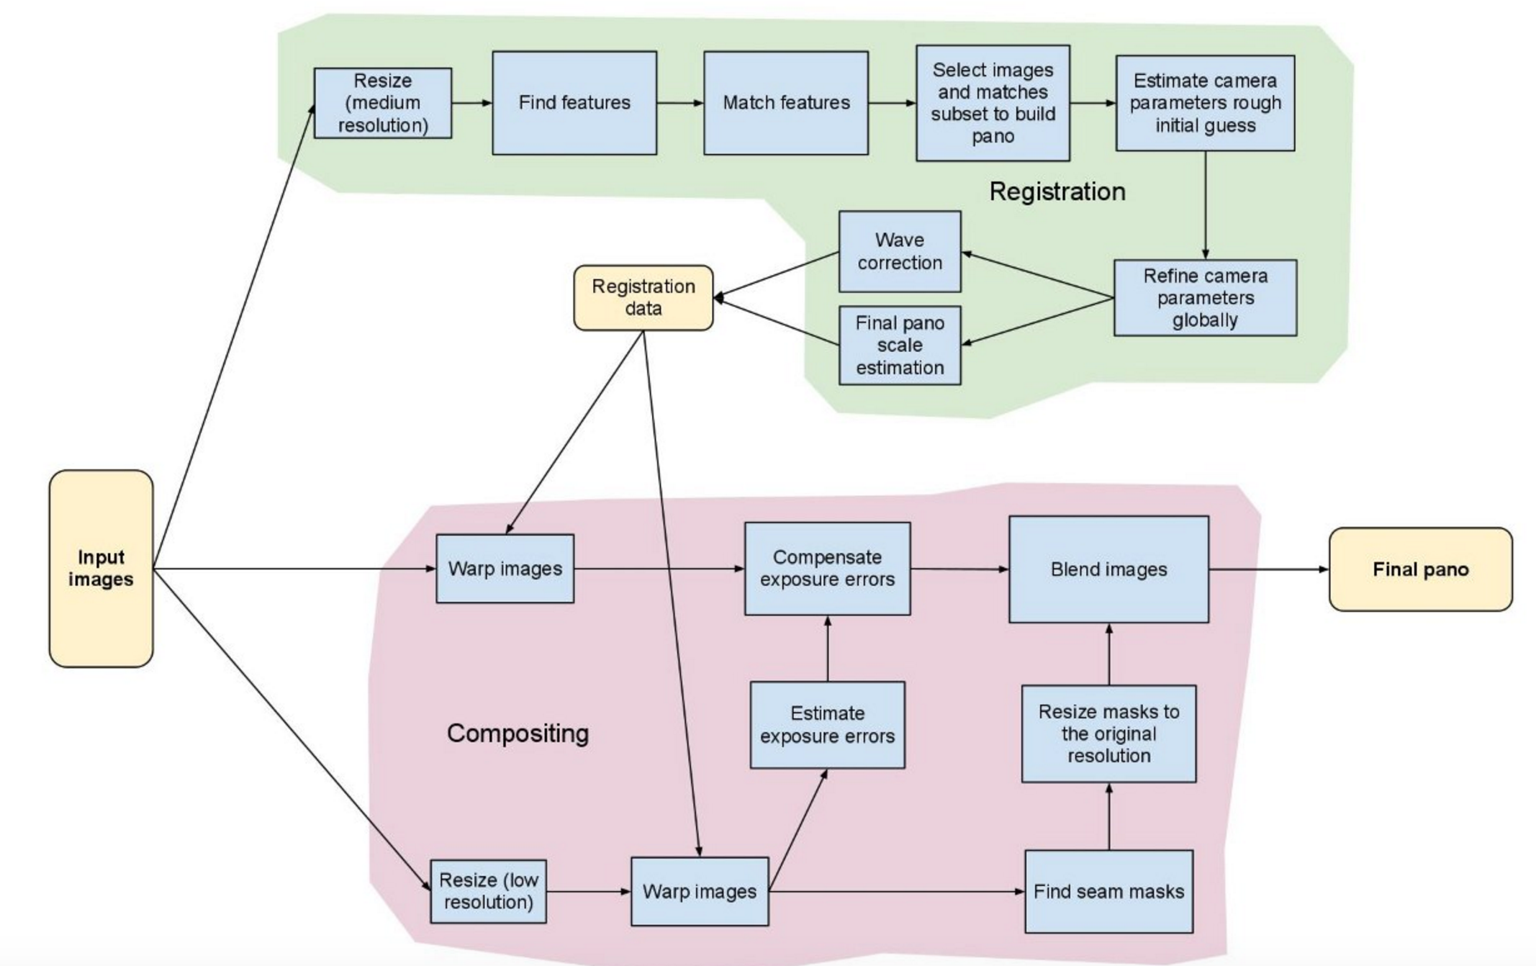
System Design and Implementation
Feature Design
Photo Taking/Editing/Gallery
Photo Categorization(Location/Time/Map)
Photo Synthesization(Panorama)[3]
Ads 

Slide 34
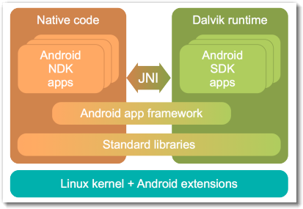
System Design and Implementation
2. Module Design
UI/UX
NDK-JNI-Feature API(OpenCV)[4]
Ads SDK
Google Map
Ads 

Slide 35
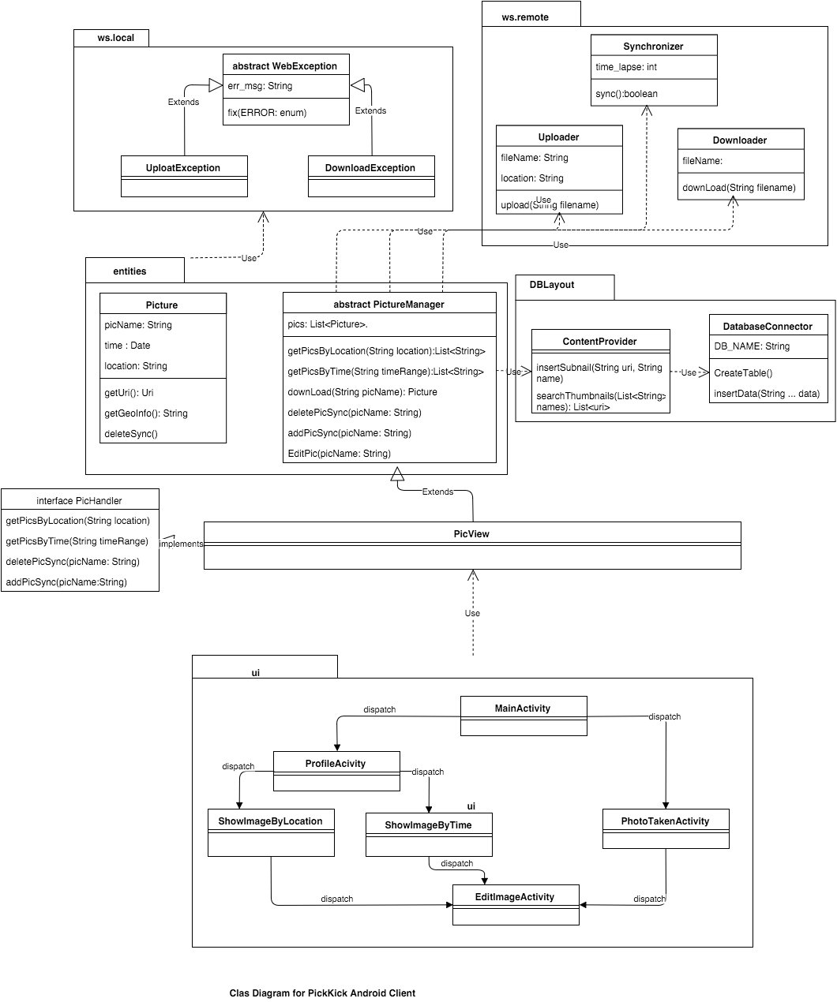
System Design and Implementation
3. UI Design/Polish
4. Construction

Slide 36
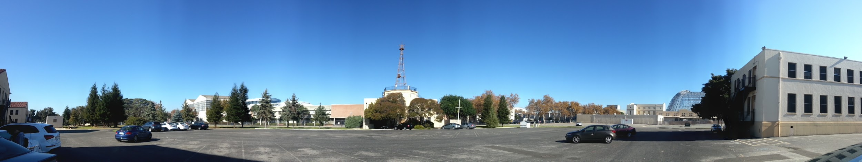
System Design and Implementation
5. Feature/Integration Test
6. Ads Embed (Google Play -> Integrate Facebook/Yahoo Ads)
Banner
Interstitial
Video
7. Play Test (2 rounds)
Ads 

Slide 37
Demo!
PicKick
https://drive.google.com/open?id=0B7k1uXNPxmkhOWJWVjZIbzg1ZW8

Slide 38
Experiment & Analysis
PicKick

Slide 39
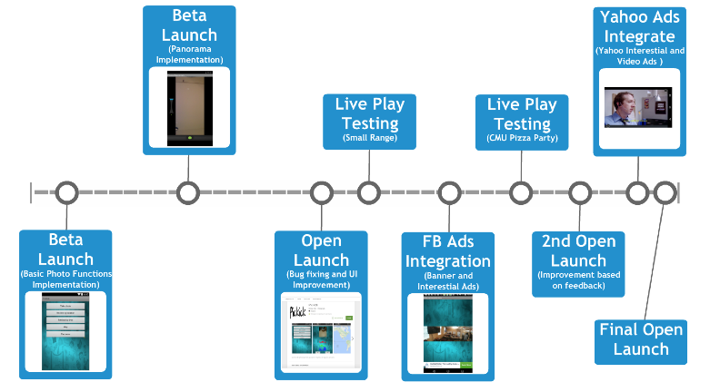
Experiment Timeline

Slide 40
Analysis & Results
Comparison integrating different Ads SDK
Facebook Audience Network (Done):
It is easy to integrate Fb SDK
The tool to measure the performance is easy and clear
Needs to wait for sophisticated authentication
Yahoo Flurry Network (Done):
The generated codes is less helpful
Needs more time to understanding the instructions
The measurement tool is more functional and complicated
Twitter Mopub Network (Failure):
Good for the enterprise users, lots of tools to measure
The SDK integration is bad, mistakes and material omission exist in the tutorial

Slide 41
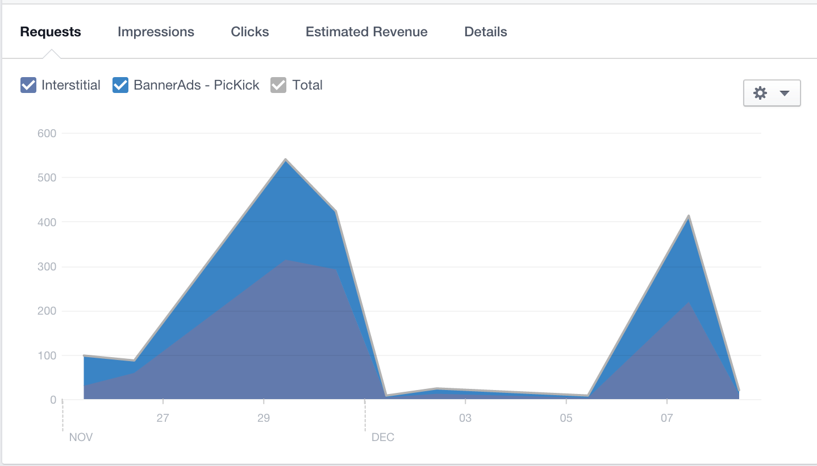
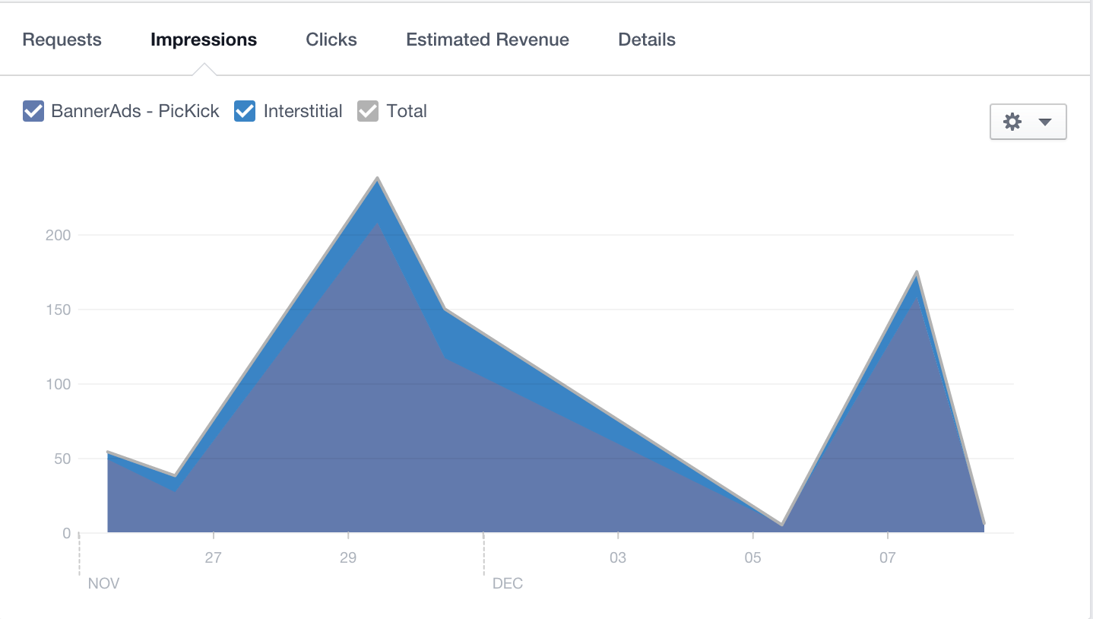
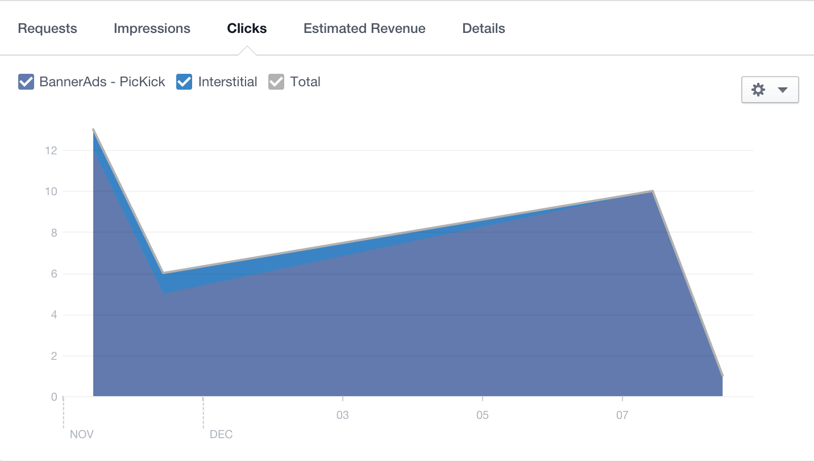
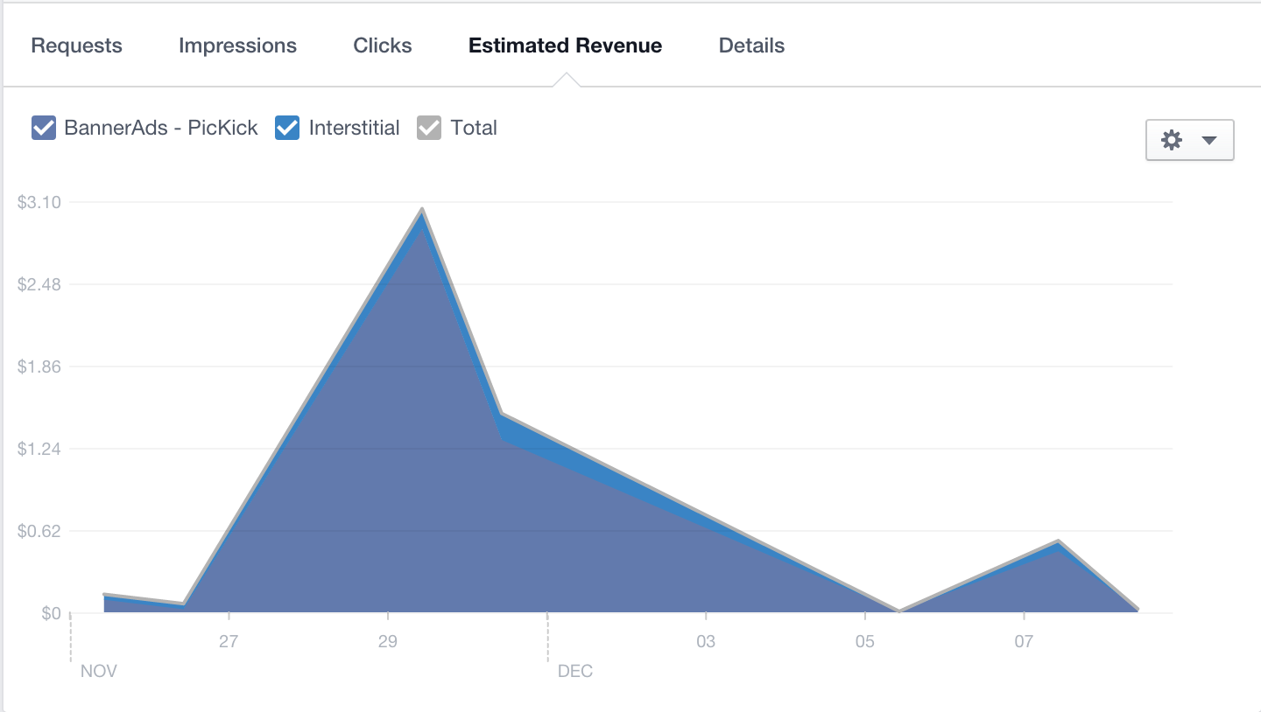
Analysis & Results
Facebook Ads Performance Analysis
Notes:
For our app, the banner’s request is less than the interstitial
The banner has better impressions and click performance
More benefits earned on banner than interstitial

Slide 42
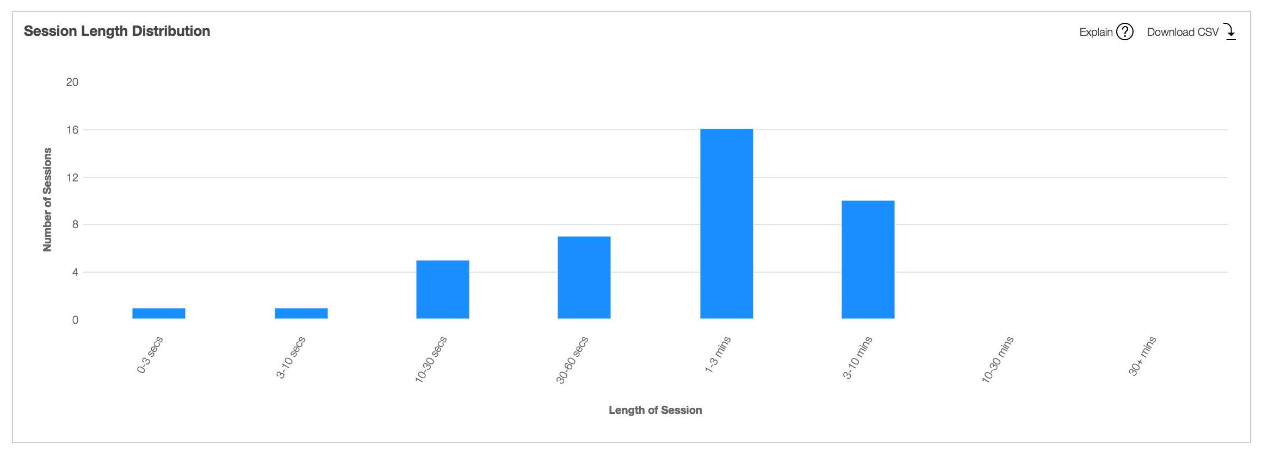
Analysis & Results
Yahoo Video Ads Analysis

Slide 43
Analysis & Results
Live Playing Test Feedback
For our apps
The Panorama function needs to improve, currently it costs user a lot of times to wait
The location category precision needs to be improved so that fewer image been overlapped
For our Ads integration
The interstitial ads may confuse the users, Yahoo has better user interaction than Facebook
The bottom banner impacts the user action less
When the more memory requested, the cooperation of interstitial ads and geo map will crash the app in many low level devices

Slide 44
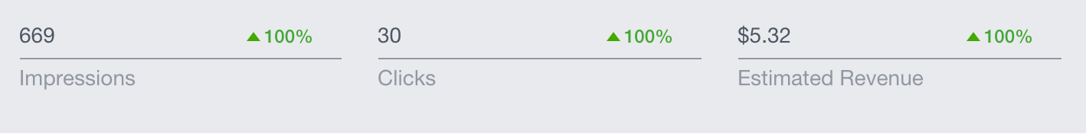
Analysis & Results
Advertising Result Summary
Ad Placements & Formats | Expected Outcome | Actual Outcome
Bottom banner ads on the several pages in PicKick | Influence the UI layout | Cause more impression, most of our test users doesn’t mind
Interstitial ads when the user view the image and map | Make users notice the ads and save the transition efforts. | Actually more memory request and confuse the users
Video ads at the transition from gallery to image | Make the apps transition good and fun to see some interesting ads | Most users will stay on the video for a while

Slide 45
Conclusion & Future Work

Slide 46
Conclusion
Native Ads - the future of Advertising.
Ad needs to be relevant to content.
Structural similarity & separation from content is a must.
Ad placement should be un-intrusive to experience & flow.
No advertising over-kill.

Slide 47
Future Works
Improvise application content & experience for user retention.
Optimize Ad placements
Implement sandwich advertising model.
Real time bidding models - MoPub.
Integrate Incentivized Ad Networks
Kipp Rewards
NativeX
Supersonic Ads

Slide 48

Thanks for your time.

Slide 49
References
[1]http://www.emarketer.com/Article/Mobile-Ad-Spend-Top-100-Billion-Worldwide-2016-51-of-Digital-Market/1012299
[2] http://searchsoftwarequality.techtarget.com/definition/Continuous-Software-Development
[3]http://docs.opencv.org/2.4/modules/stitching/doc/introduction.html
[4]http://tahins.blogspot.com/2012/04/android-tutorial-part-1-what-is-android.html

